Slide 1
Multiple GPU testing

Slide 2
Model partitioning
2 GPUS, so 6-layer LeNet model partitioned into 2 splits
conv1
pool1
Split 1, Cell 0
conv2
pool2
fc1
Split 2, Cell 1
sm1

Slide 3
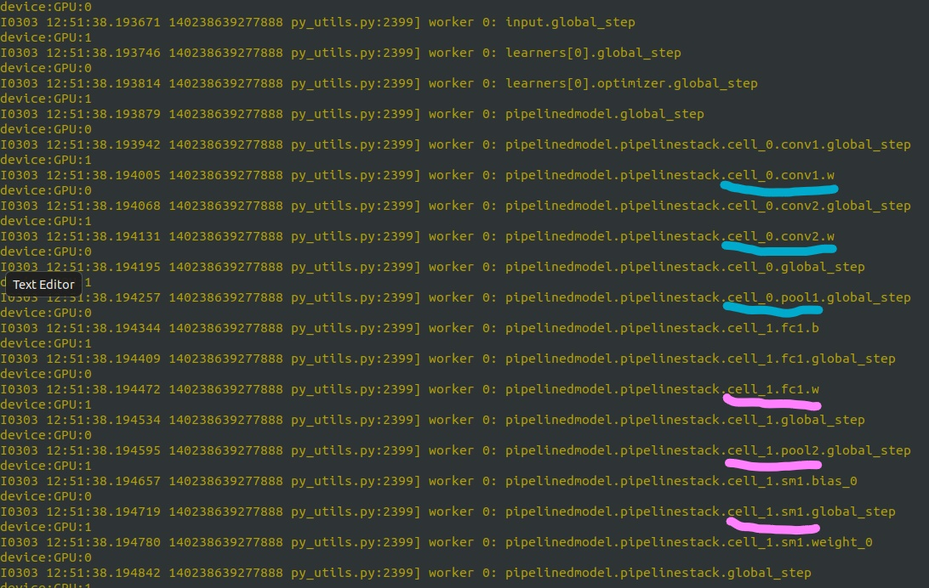
Model partitioning

Slide 4
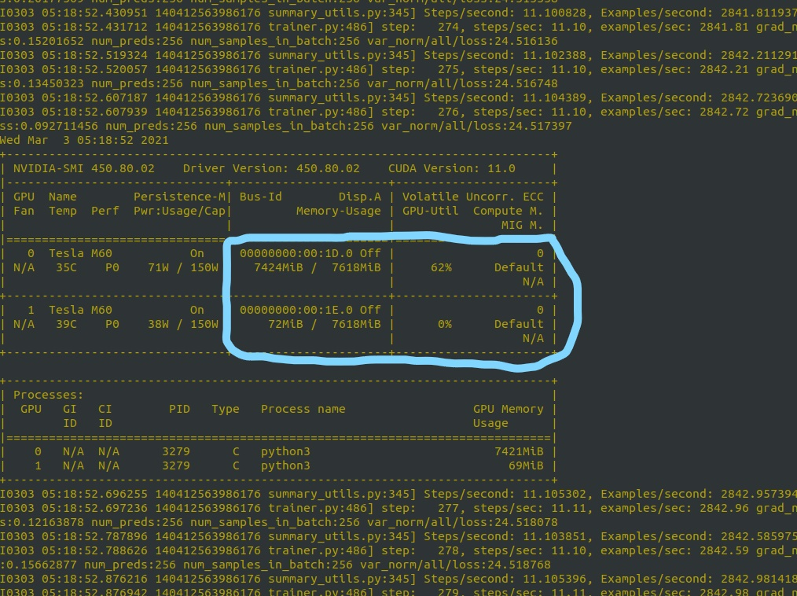
Single GPU execution
Pass additional parameters to run on multiple gpus.
Only GPU:0 is being used

Slide 5
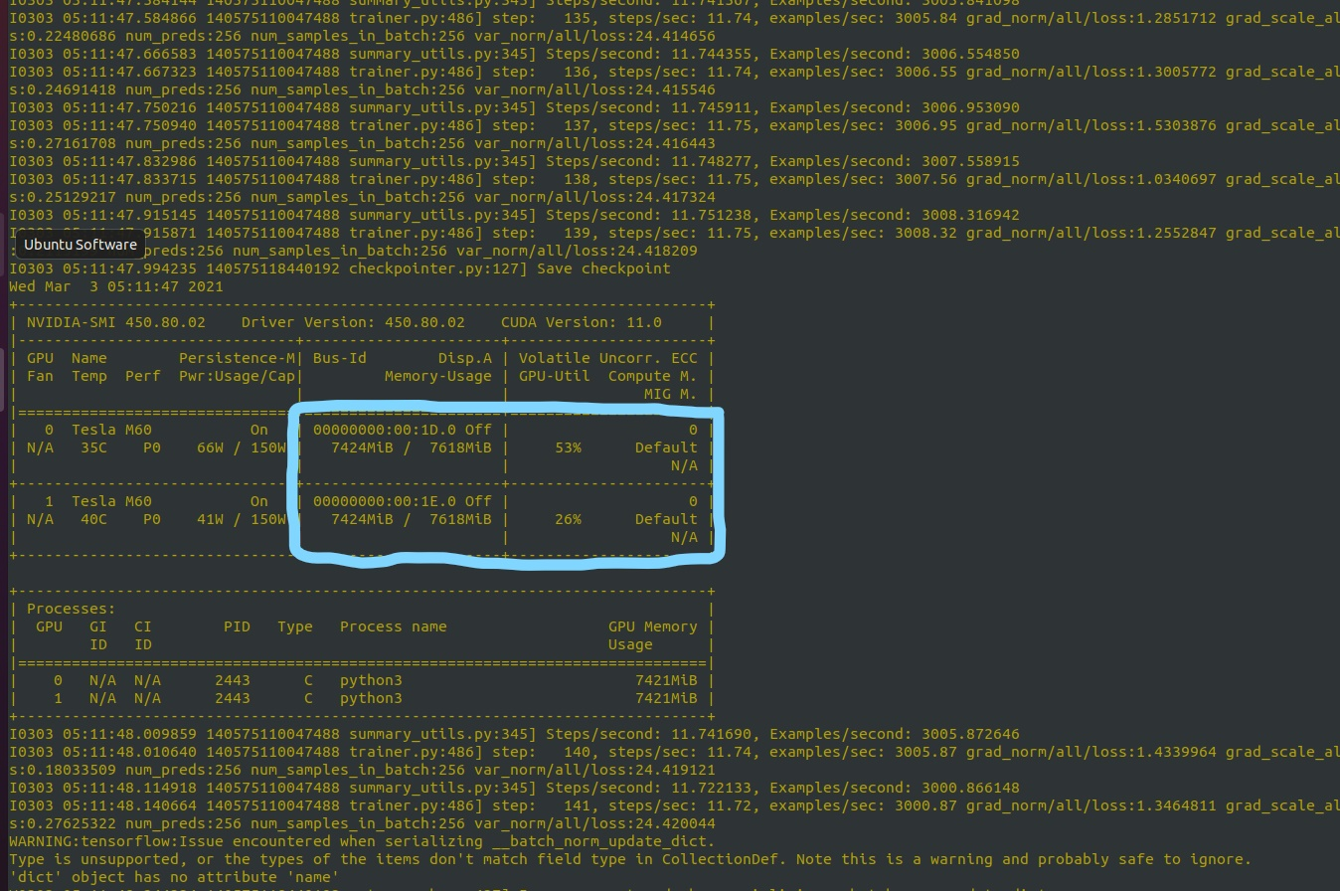
Multiple GPU execution
Notice difference in arguments
Both gpus being used this time

Slide 6
Communication between splits (2 gpus)
Recap the model partitioning
conv1
pool1
conv2
pool2
fc1
sm1
Split 0. Sends data from conv2 to split 1 during forward prop
Split 1. Sends gradients from pool2 to split 0 during backprop

Slide 7
Forward Prop communication
Sending device, GPU:0
Receiving device, GPU:1
Conv2 layer’s output is sent to next split

Slide 8
Backprop communication
Gradient from pool2 is sent to previous split
Sending device is now GPU:1
Receiving device is now GPU:0

Slide 9
Communication when using 1 gpu
Forward prop
Notice that sender and receiver are both the same, i.e. GPU:0

Slide 10
Communication when using 1 gpu
Backprop
Same device is used in backprop also

